Slide 1

Building a REST API with Django
By Sam Eskandar

Slide 2
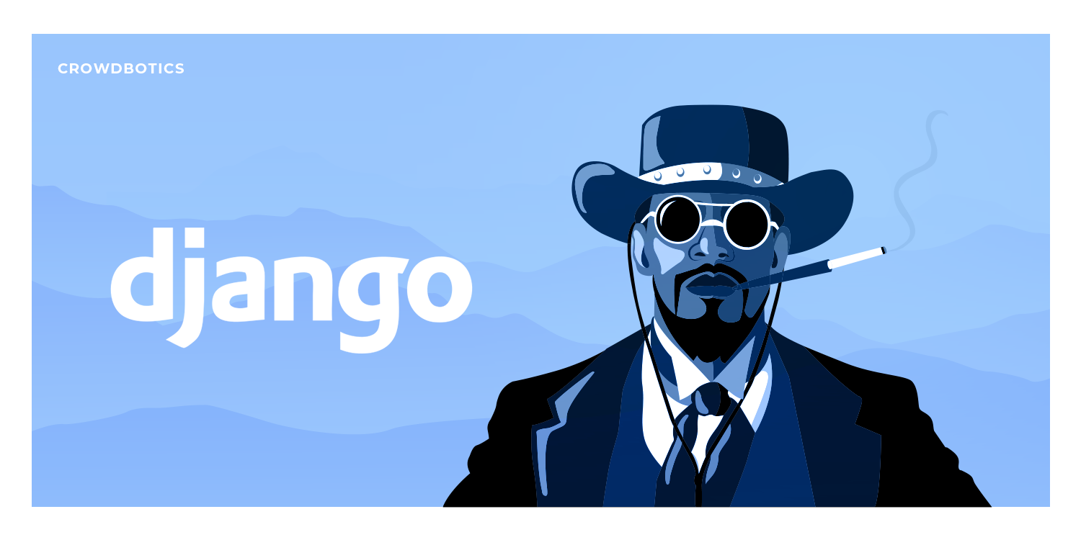
Table of Contents 1. What is a REST API? 2. Integration with Django 3. Project setup and demo 4. Building the project

Slide 3
What is a REST API
- REST or Representational state transfer is a software architectural style for building API’s. Essentially rules.
- REST Anatomy:
Endpoints
Methods
Request Headers
Request body and Responses
- TL;DR Just think CRUD

Slide 4
Integration with Django
Serializers
Views
Urls
Definition:
A class that turns arbitrary queryset/model data into native Python data types that can be rendered as JSON or XML
Think middle man in the transaction
Definition:
A function or class containing methods to turn a request into a response
Think actual brains of endpoint
Definition:
An endpoint or route comprised of a base url and relative path
https://api.github.com/users/s6eskand
BASE
PATH

Slide 5
Project Setup and Demo
- Prerequisites:
Mandatory: Django, Pip, Python 3.x
Optional: Git, Conda (or any venv setup)
Some knowledge of Django would be nice
You should probably know Python lol
- Live project at: https://music-listing.netlify.app

